Slide 1
FB pages analysis
Munteanu Bianca-Ștefania - BD
Murariu Alexandra - ICA
Munteanu Tudor - BD

Slide 2
1. Description of the network
Real
Name: Facebook Food Pages
Category: Sparse Networks
Collection: Social Networks
Type: undirected network
N = 620 nodes as facebook pages names
L = 2102 edges between mutually liked pages
Erdos-Renyi
random network
Type: undirected network
N = 620 nodes
L = 2076 edges
Barabasi-Albert
scale-free network
Type: undirected network
N = 620 nodes
L = 1851 edges

Slide 3
2. Network properties
Real
The network is connected, so it has only 1 connected component
Average degree: 6.78
Size of the largest connected component: 620
Min degree= 1 Max degree= 134
Avg degree is closer to the min degree, while max degree is much higher than min/mean (skewed degree distribution) => first indication the network could be a power-low (or some heavy-tailed distribution), but this is not yet fully confirmed.
Erdos-Renyi
The network is connected, so it has only 1 connected component
Average degree: 6.69
Size of the largest connected component: 620
Min degree= 1 Max degree= 16
=> narrow degree distribution, mean (6.69) is approx in the middle of the range (1 to 16). It indicates a random network.
Barabasi-Albert
The network is connected, so it has only 1 connected component
Average degree: 5.97
Size of the largest connected component: 620
Min degree= 3 Max degree= 62
Avg degree is closer to the min degree, while max degree is much higher than min/mean (skewed degree distribution) => first indication the network could be a power-low (or some heavy-tailed distribution), but this is not yet fully confirmed.

Slide 4
Is the network highly clustered?
Real
Diameter of G: 17
Average shortest path length: 5.088696649121893
Average clustering coefficient: 0.3308970263553271
Edge density: 0.0109541925061233
avg clustering coeff >> edge density, moderate to high level of clustering, but it is sparse overall (because of the low edge density)
Erdos-Renyi
Diameter of G: 7
Average shortest path length: 3.59604460889051
Average clustering coefficient: 0.008639389284550571
Edge density: 0.010818698212517588
Avg clustering coeff < edge density, low clustering
Barabasi-Albert
Diameter of G: 6
Average shortest path length: 3.352733336807546
Average clustering coefficient: 0.038244647852887725
Edge density: 0.0096461514409297
avg clustering coeff > edge density, but the value of the clustering coefficient is still on the lower side, so we can not say that the network is highly clustered

Slide 5
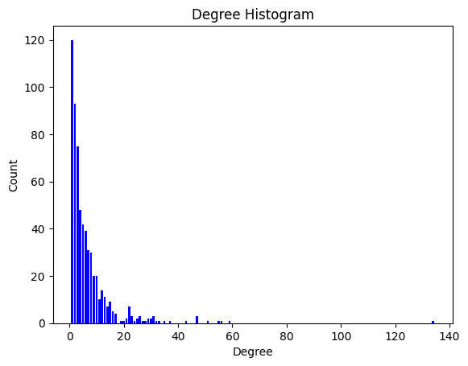
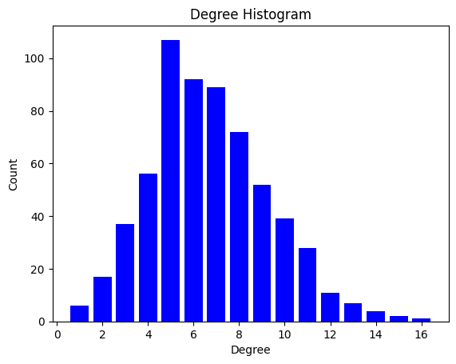
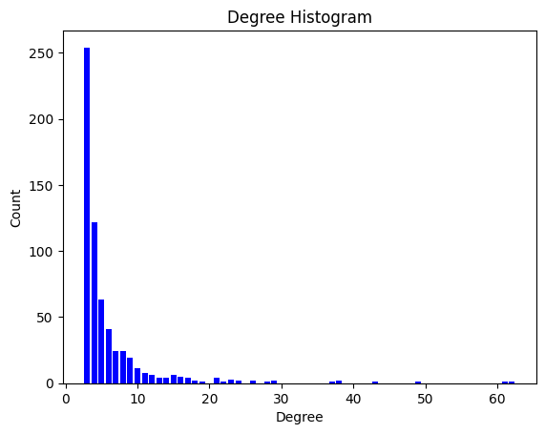
3.1. Plots – Degree distribution
Barabasi-Albert
majority of nodes have a low degree
there are a few nodes with a very high degree, which act as highly connected hubs
distribution is a clear indicative of a scale-free network, which is characterized by a power-law degree distribution
Real
majority of nodes have a low degree
there are a few nodes with a very high degree.
distribution may suggest a scale-free property, where some nodes act as highly connected hubs
Erdos-Renyi
the degree of most nodes is in the vicinity of k
distribution may suggest binomial

Slide 6
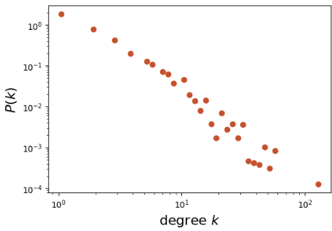
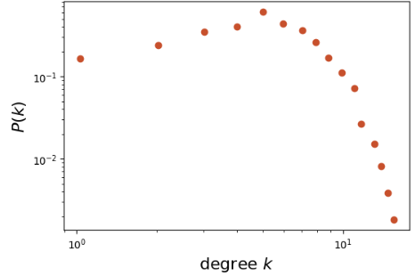
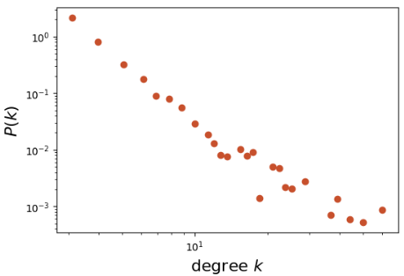
3.2. Log Log Plot Analysis
Real
from earlier we know that the avg degree is closer to the min degree
shows a linear trend on the log-log scale, especially in the tail (higher-degree part) => heavy-tailed distribution, characteristic of power-law behavior.
however, some deviation from a straight line can be observed => the network follows a power-law only approximately or for a certain range of degrees.
Erdos-Renyi
from earlier we know that the avg degree is about in the middle
it appears to have a concave downward shape. The tail follows almost a straight line, an indication of a power-law distribution, but the initial slope is completely different (we can observe the threshold phenomena).
Barabasi-Albert
from earlier we know that the avg degree is closer to the min degree
shows a linear trend in the middle of log-log scale => characteristic of power-law behavior
however, some deviation from a straight line can be observed at the beginning and end of the distribution

Slide 7
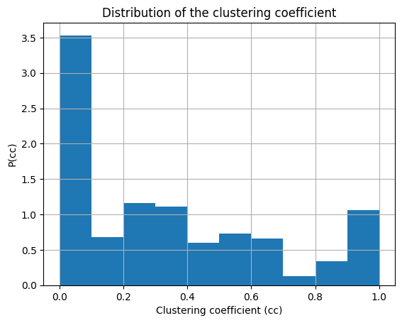
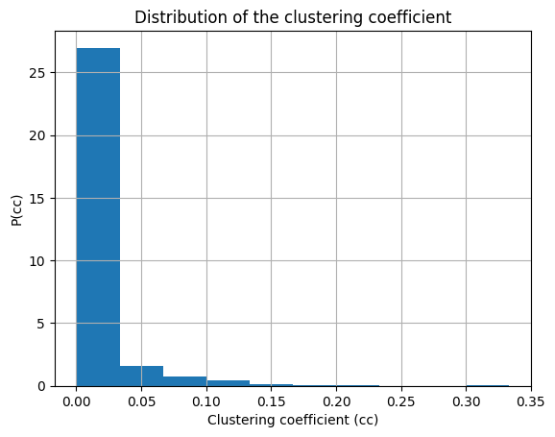
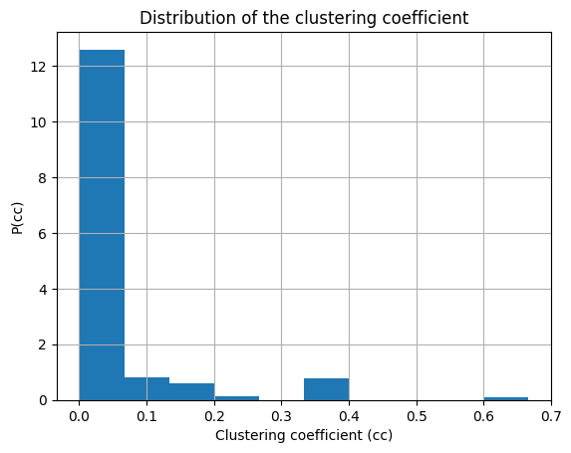
3.3. Plots – Distribution of the clustering coefficient
Barabasi-Albert
in scale-free networks, many nodes tend to have few connections, and these connections are less likely to form closed triangles, resulting in lower clustering coefficients for those nodes
the few highly connected nodes (hubs) might be part of clusters
Real
the nodes with a clustering coefficient of 0 do not form triangles with their neighbors
there are also nodes with higher clustering coefficients, suggesting that many nodes do tend to form triangles with their neighbors
the spread of values indicates heterogeneity in the local clustering of the network
Erdos-Renyi
the nodes with a clustering coefficient of 0 do not form triangles with their neighbors
the distribution is quite skewed, with a large number of nodes having a low clusering coefficient

Slide 8
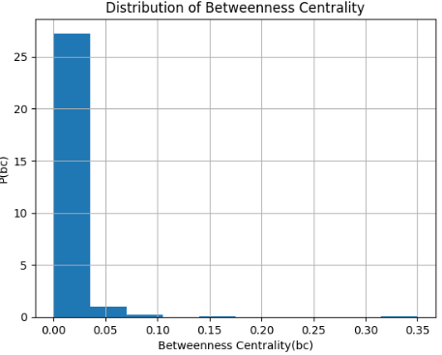
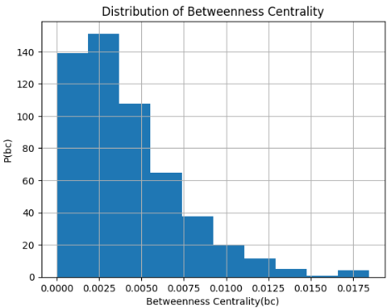
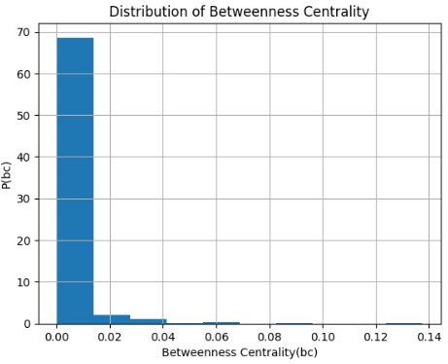
3.4. Plots – Betweenness centrality plot analysis
Real
distribution is quite skewed, with a large number of nodes having a low betweenness centrality value, which is typical for many real-world networks.
most nodes are not often on the shortest paths between other nodes, with only a few nodes having higher betweenness centrality
Erdos-Renyi
distribution is quite skewed, with a large number of nodes having a low betweenness centrality value. The tail is long, extending towards the higher values.
most nodes have a low betweenness centrality, which is expected from a random, non-structured network.
Barabasi-Albert
distribution is heavily right-skewed, with a large number of nodes having a low betweenness centrality value
most nodes are not often on the shortest paths between other nodes, with only a few nodes having higher betweenness centrality

Slide 9
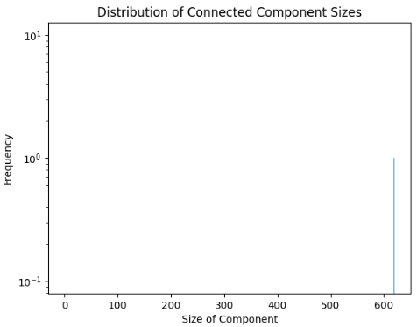


3.5. Plots – Connected components plot analysis
all networks have only one connected component, so we see only one bar on the plots​
this is not meaningful for our network
Real
Erdos-Renyi
Barabasi-Albert

Slide 10
4. Most important nodes
 | Real | ER | BA
Node with the highest degree | 265 (Degree: 134) | 157 (Degree: 16) | 0 (Degree: 62)
Node with the highest clustering coefficient | 1 (Clustering Coefficient: 1.0) | 442 (Clustering Coefficient: 0.33) | 114 (Clustering Coefficient: 0.66)
Node with the highest degree centrality | 265 (Degree Centrality: 0.21) | 157 (Degree Centrality: 0.025) | 0 (Degree Centrality: 0.100)
Node with the highest betweenness centrality | 265 (Betweenness Centrality: 0.349) | 235 (Betweenness Centrality: 0.018) | 0 (Betweenness Centrality: 0.137)
Node with the highest closeness centrality | 265 (Closeness Centrality: 0.331) | 6 (Closeness Centrality: 0.329) | 0 (Closeness Centrality: 0.445)
Node with the highest eigenvector centrality | 265 (Eigenvector Centrality: 0.325) | 6 (Eigenvector Centrality: 0.116) | 0 (Eigenvector Centrality: 0.353)

Slide 11
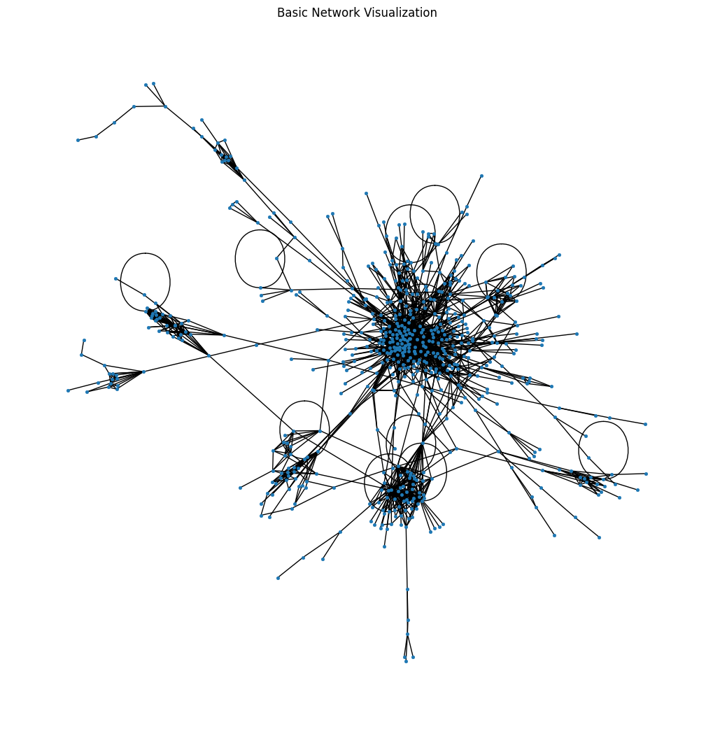
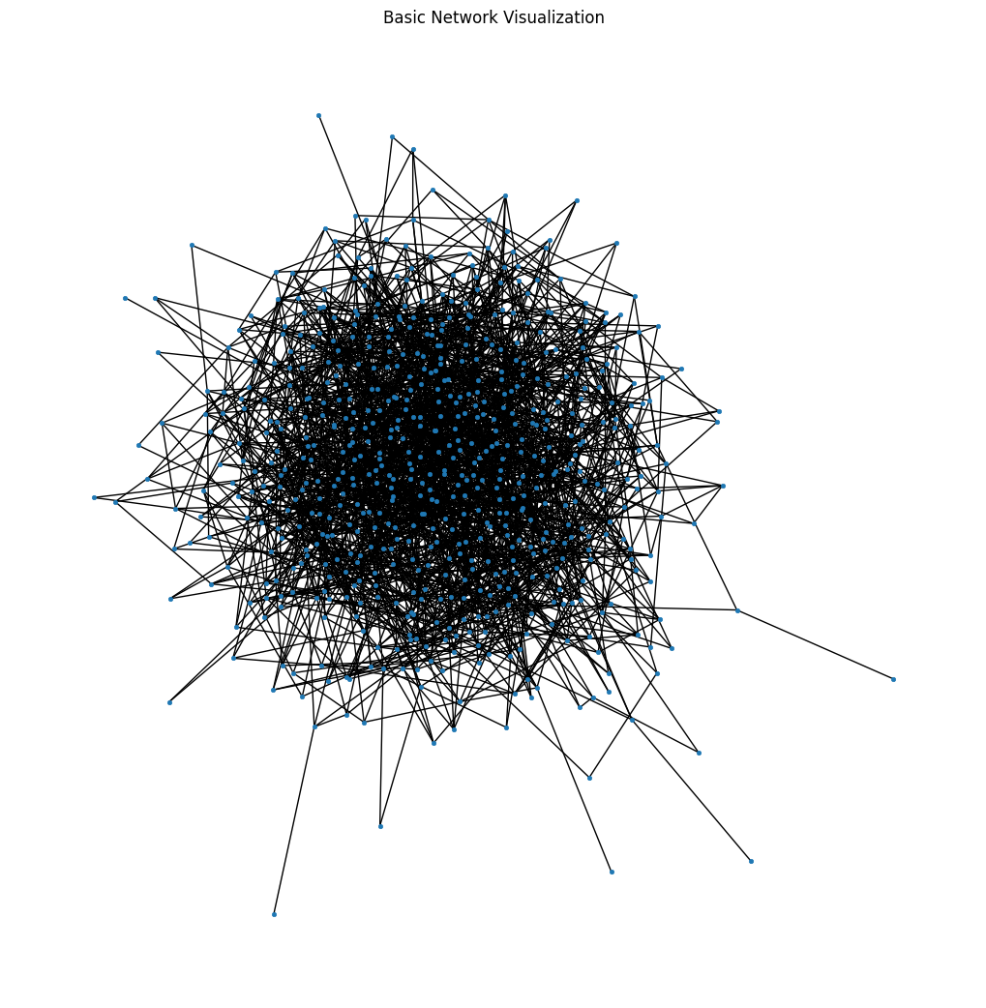
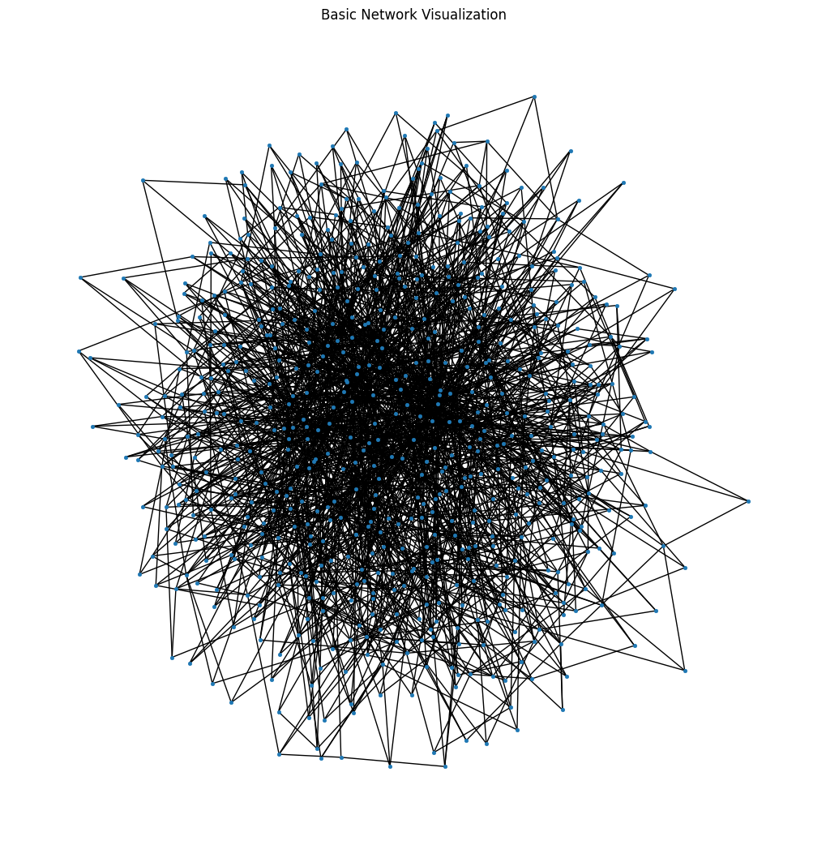
5.1. Visualization – Basic initial exploration of the network to understand its general structure and connectivity
Real
Erdos-Renyi
Barabasi-Albert

Slide 12
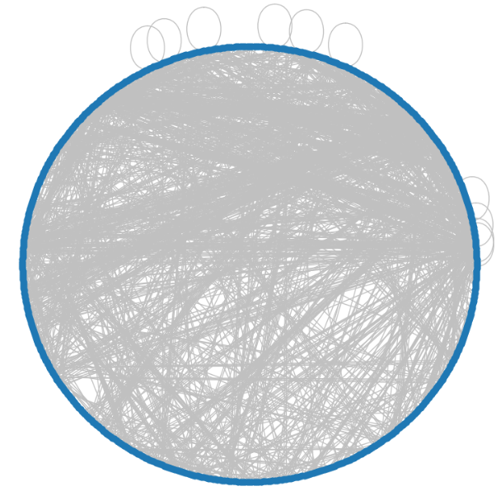
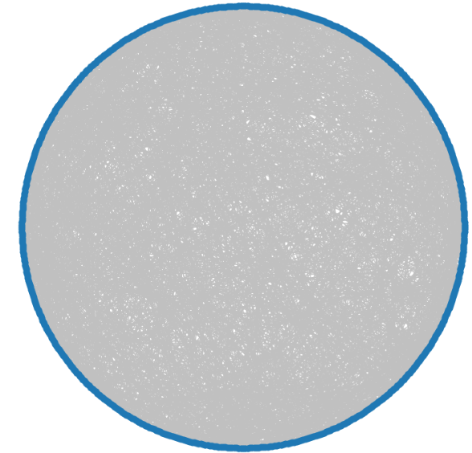
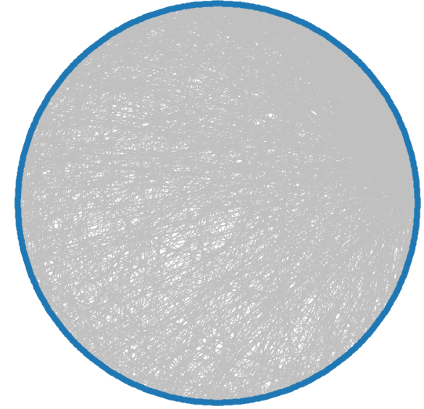
5.2. Visualization – Circular circular layout, useful for spotting symmetries
Erdos-Renyi
Barabasi-Albert
Real

Slide 13
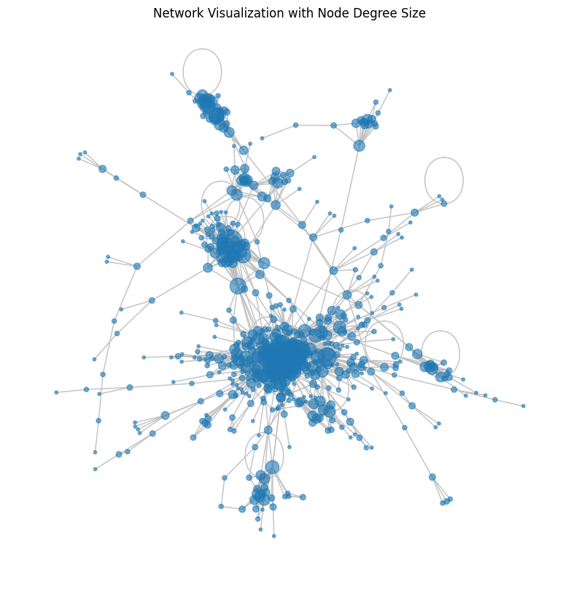
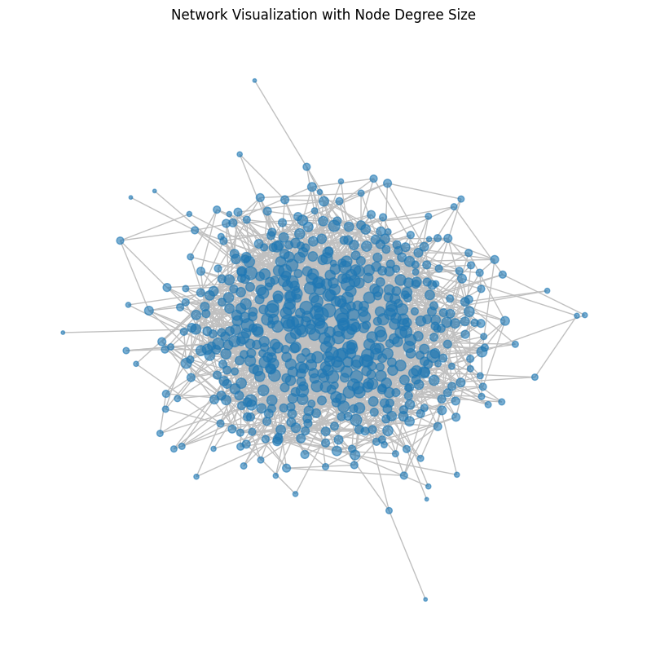
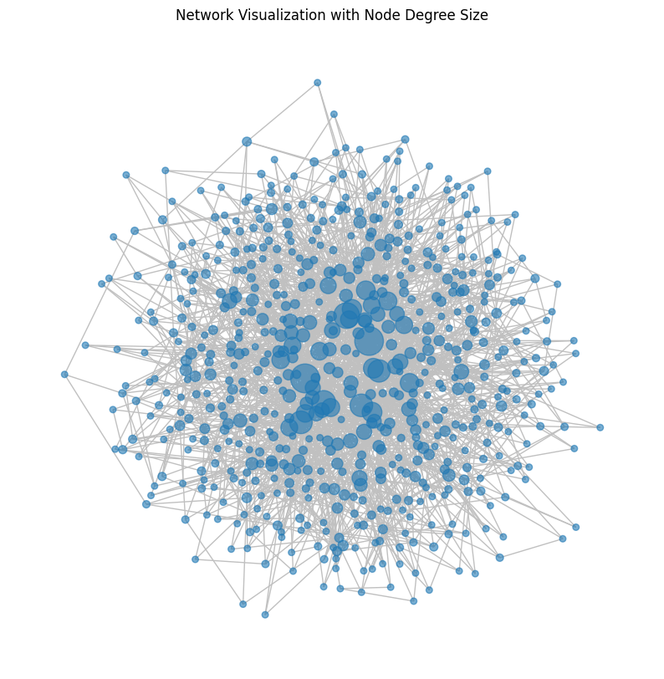
5.3. Visualization with Node Degree Size useful for quickly identifying important nodes or hubs within the network
Real
Erdos-Renyi
Barabasi-Albert

Slide 14
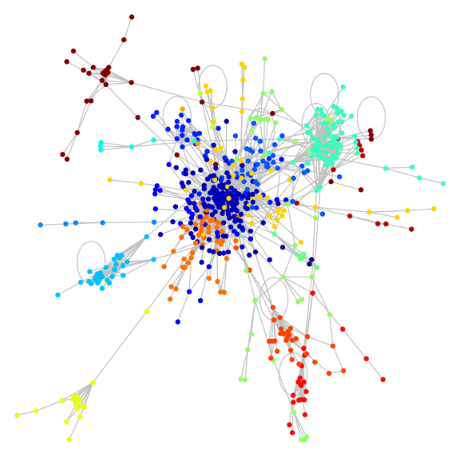
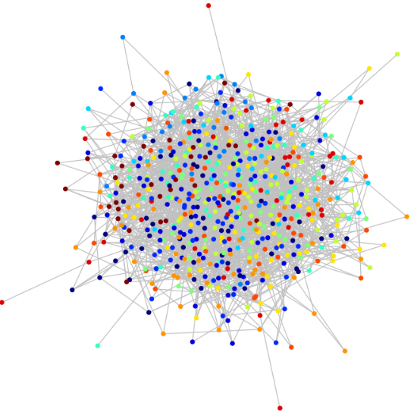
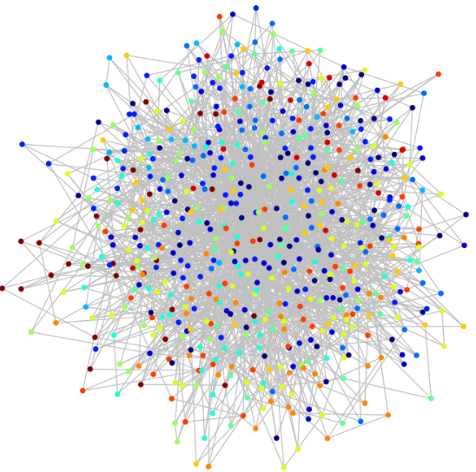
5.4. Visualization – Community segregates communities within the network
Real
Erdos-Renyi
Barabasi-Albert

Slide 15
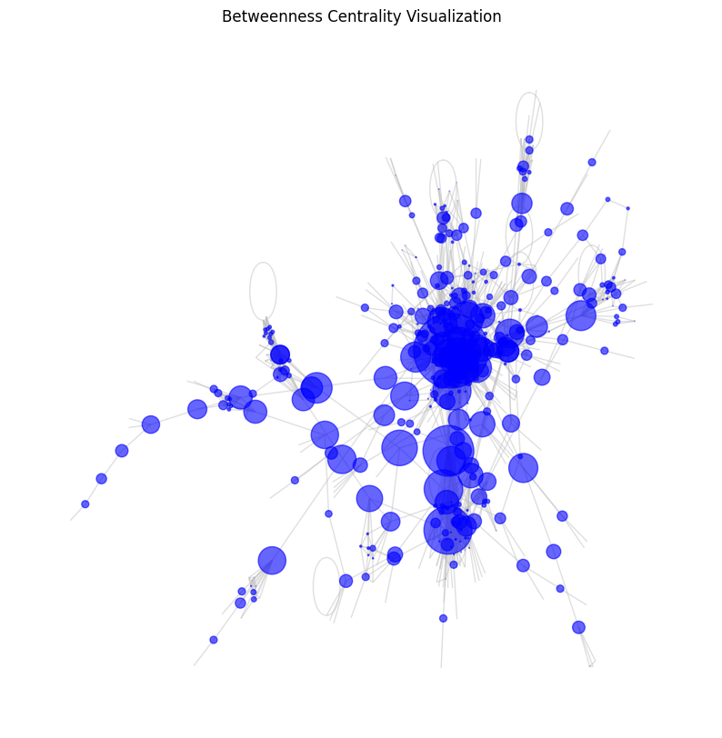
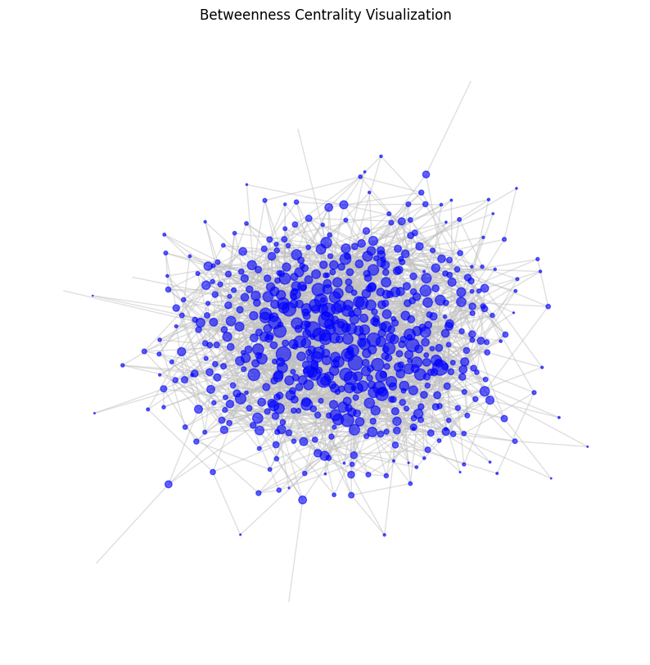
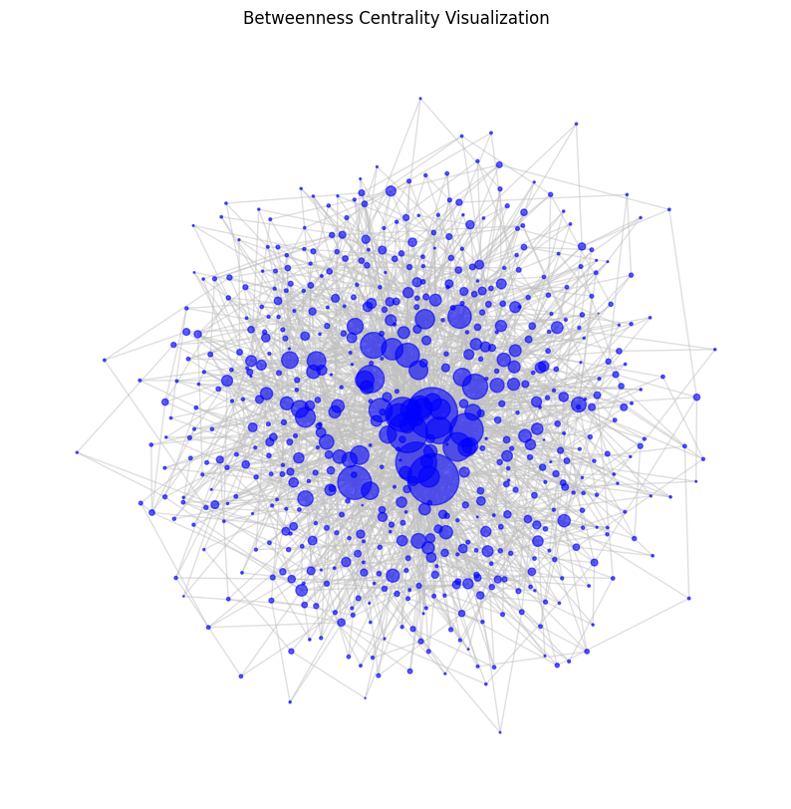
5.5. Visualization with Betweenness Centrality emphasizes nodes that serve as critical connectors or bridges within the network
Real
Erdos-Renyi
Barabasi-Albert

Slide 16
6. What type of network is the selected network?
We believe that the selected network is most similar to a scale-free network, looking at the similarities of the log-log plot, and community spread, as well as the circular and betweenness centrality visualizations.
We also considered the computed metrics in the comparison, such as the similarities found in the edge densities and clustering coefficients.

Slide 17
Reddit network analysis

Slide 18

Data Collection
Our study extracts data from the popular social platform Reddit, specifically focusing on a subreddit community.
API Registration & Access: Python Reddit API Wrapper (PRAW).
Subreddit Selection: one with vibrant discussions and diverse user interactions
Data Extraction: top posts from the subreddit, with the comments and the user metadata
Network:
node = unique Reddit users (approximately 200 nodes)
edges = replies between users
Sentiment Analysis Integration:
Hugging Face’s pre-trained DistilBERT model
assign sentiment scores to the interactions

Slide 19
Investigative Objectives in Network Analysis
Centrality of Negativity: Does a pattern exist where users frequently engaging in negative comments become central to the network?
Echo Chambers & Sentiment: How does the sentiment of user comments reflect potential echo chambers within the subreddit? Our analysis will seek to uncover whether users with similar sentiment scores are more densely interconnected.
Sentimental Pathways: What is the nature of sentiment propagation across the network? Investigating the spread of sentiment scores through user interactions could reveal how positive or negative emotions spread within the community (Betweenness centrality)

Slide 20
Thank you!

